Slide 1
Luck or Skill?
CS 5830 · PROJECT 3
Do Premier League teams really earn their goals, or do they just get lucky?
Kameron Moss, Prashant Aryal
Notes:
Hi everyone. Our project asks a question every soccer fan argues about: when a team scores a ton of goals, is that skill, or did they just get lucky? We used 13 seasons of Premier League data to find out.

Slide 2
If a team beats its xG, is it skill or luck?
THE QUESTION
xG (expected goals) = how many goals a team should have scored from its chances. Luck shouldn't repeat next season. Skill should.
Clubs & scouts
Fans & pundits
Analysts
Don't pay big money for one lucky season.
Know if your team's hot streak will last.
Pick better numbers to predict results.
2
Notes:
Quick definition first: xG, or expected goals, is how many goals a team should have scored based on the quality of its chances. So if a team scores way more than its xG, it's either really good at finishing or it got lucky. Our test is simple: luck shouldn't repeat next season, but skill should. This matters because clubs spend millions after one good season, and fans and analysts want to know if a streak is real.

Slide 3
Every Premier League game since 2013-14
THE DATA
13
4,940
0.32
seasons
games
goals per shot on target
This didn't make sense at first: the site had no real xG. So we built our own, where every shot on target is worth 0.32 goals.
3 · Source: football-data.co.uk
Notes:
We pulled every Premier League game from football-data.co.uk: the score, shots, and shots on target. The first problem was that the site doesn't have real xG. So we made our own: across the league, about 32% of shots on target go in, so each shot on target counts as 0.32 expected goals. We started at 2013-14 because that's when the site changed how it counts shots on target. That gave us 13 seasons and 4,940 games.

Slide 4

We scraped 26 seasons in one script
HOW WE GOT IT
1
2
3
4
Read the index
Find the files
Download politely
Combine & save
requests loads the site's England results page
BeautifulSoup pulls every Premier League CSV link
1-second pause per file, labeled as a student project
9,880 games cached to one CSV so we scrape once
Sources
Data: Football-Data.co.uk, England football results — football-data.co.uk/englandm.php (seasons 2000-01 to 2025-26)
Tools: Python · requests · Beautiful Soup 4 (html5lib) · pandas
Code: github.com/PrashantAryal/CS_5830_Project3
4
Notes:
Since this project is about data scraping, here's how we got our data. Our script loads the England results page on football-data.co.uk with requests. Then BeautifulSoup finds every link to a Premier League season file, which the site names E0.csv. We downloaded all 26 seasons from 2000-01 to 2025-26. We tried to scrape politely: we waited one second between files and sent a user-agent that says it's a student project. Some of the older files were messy, with extra columns and different text encodings, so we handled those while reading them. Everything got combined into one CSV of 9,880 games and saved, so we only had to scrape once. All of our code is on GitHub.

Slide 5
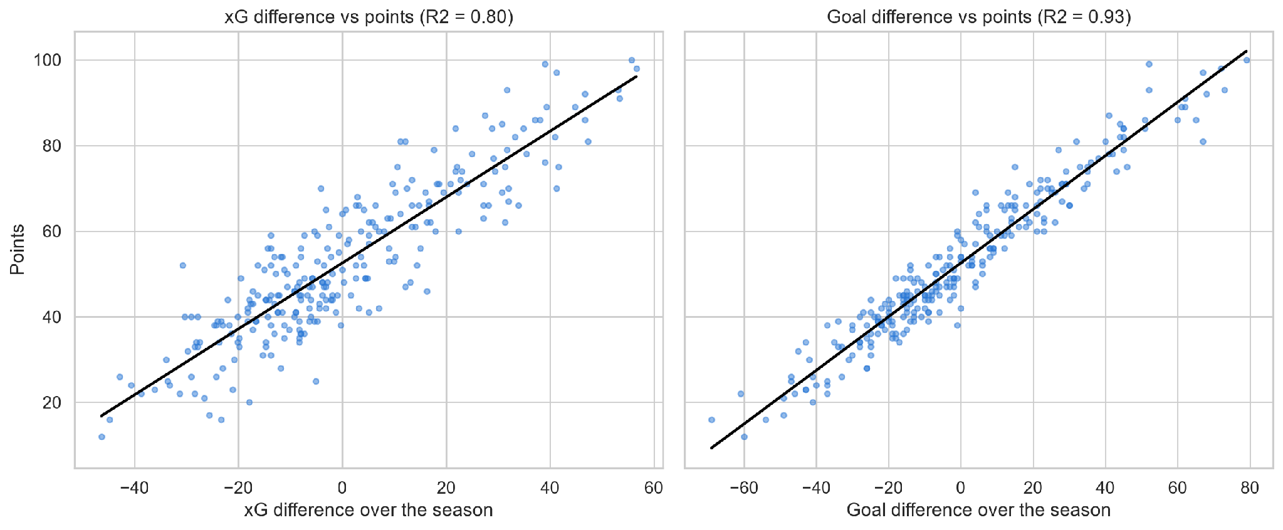
Chances decide most of the table
FINDING 1
80%
of a team's points are explained by the chances it creates and allows.
Actual goals explain 93%, so finishing still matters a little.
5 · 260 team-seasons
Notes:
Each dot is one team in one season. On the left, chance difference vs points. On the right, goal difference vs points. Chances alone explain 80% of where a team finishes. Actual goals explain 93%, so that extra 13% is the part where finishing, or luck, comes in. This matters because it means you can mostly judge a team by the chances it creates.

Slide 6
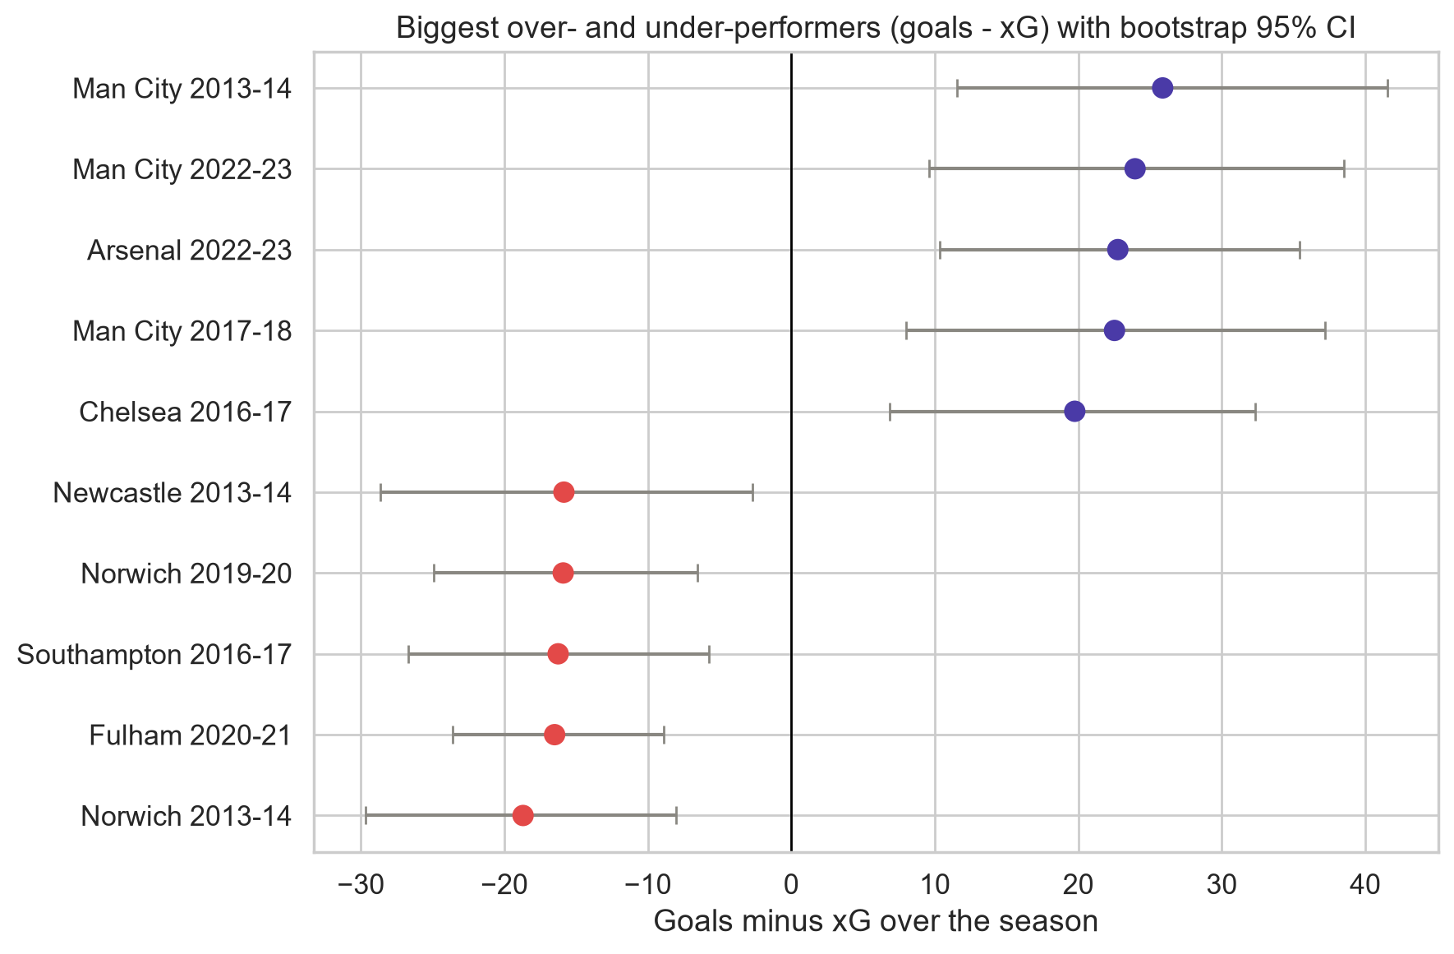
Some teams are way off their xG
FINDING 2
15%
of team-seasons were off by more than luck explains. Luck alone would give about 5%.
Man City 2013-14: 102 goals from 76 xG.
6 · Bars = bootstrap 95% range
Notes:
This result surprised us. Man City in 2013-14 scored 102 goals when their chances were only worth 76. Norwich that same year scored 28 from 47. The grey bars show the range we got by reshuffling each team's games 10,000 times, and none of them cross zero, so these gaps aren't just luck. Overall, about 15% of team-seasons were off by more than luck would explain, when you'd expect only about 5%.

Slide 7
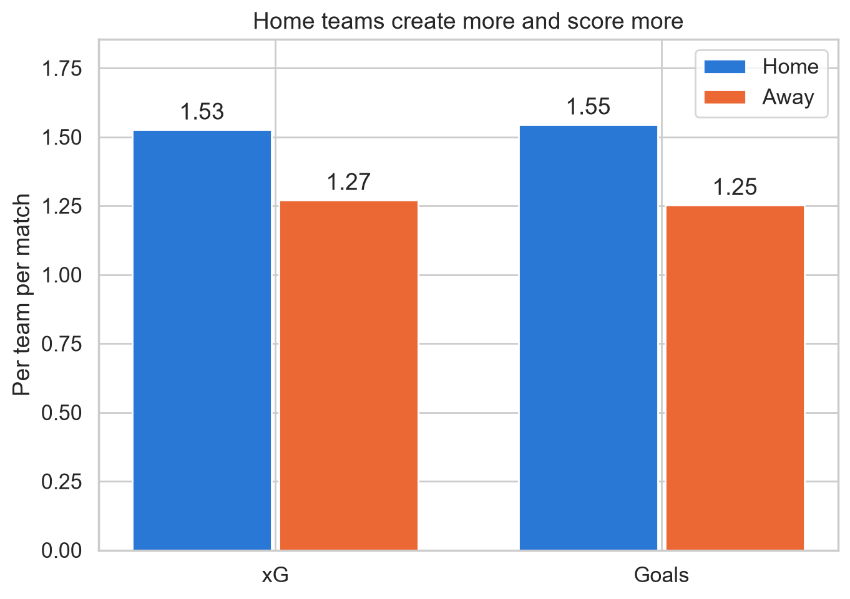
Home teams get more chances, not better finishing
FINDING 3
+0.26 xG
per match for home teams (p < 0.001).
But they score about what their xG says (p = 0.22). They just get more and better shots.
7 · Per team per match
Notes:
Everyone knows home teams win more. We wanted to know why. It can be explained by chances: home teams create about a quarter of a goal more xG per match. But once they get those chances, they don't finish any better than away teams. So home advantage is about getting more shots, not shooting better.

Slide 8
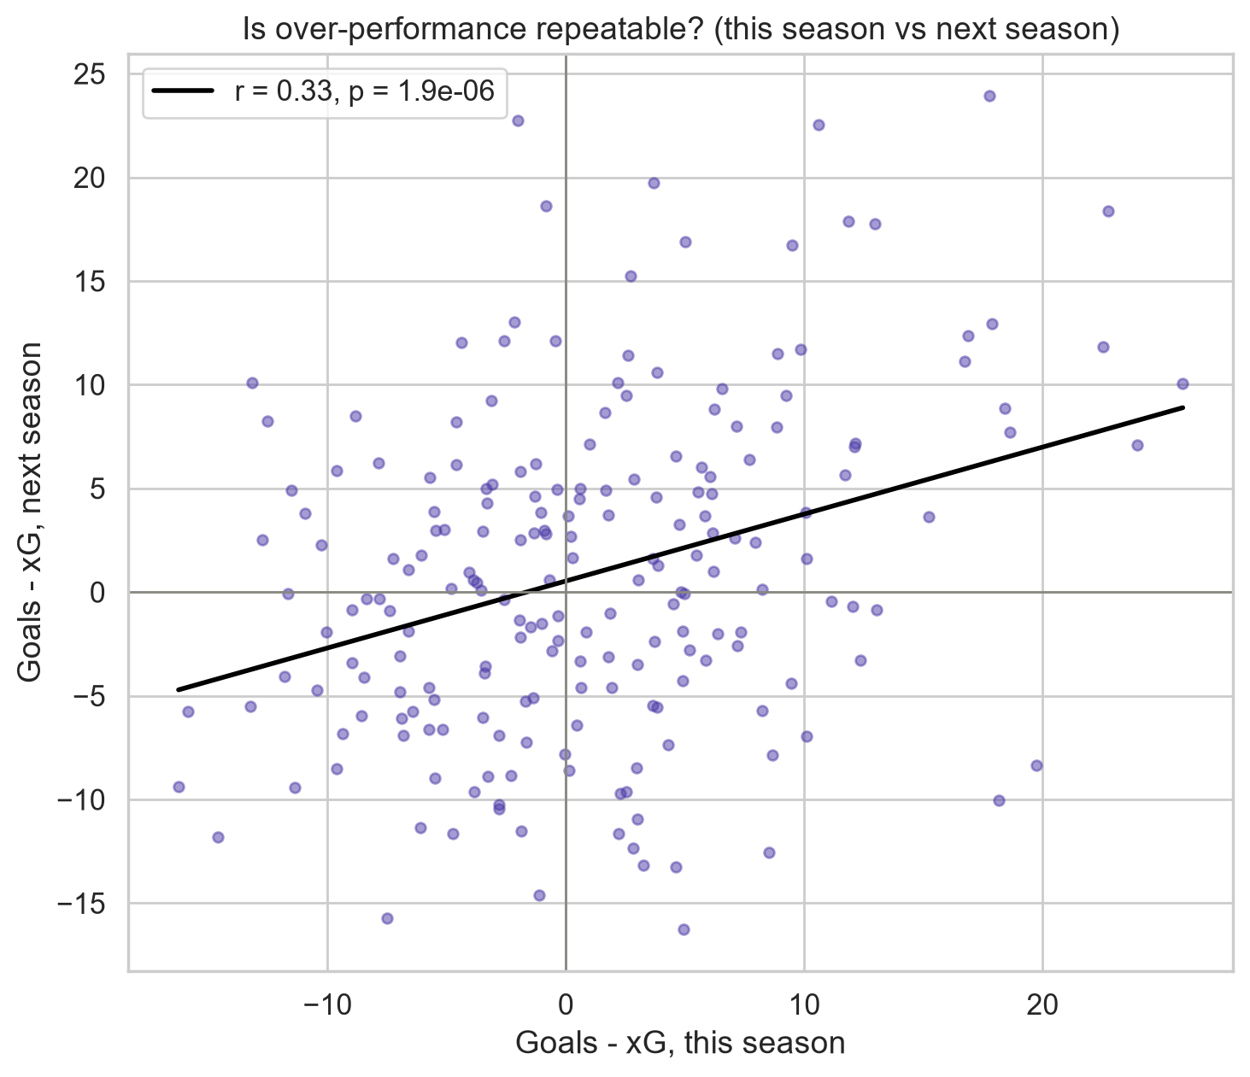
Beating xG only partly repeats
FINDING 4
About 1/3
of a team's over-performance carries into next season (r = 0.33). The rest goes away.
It shows up in home games, not away games.
8 · 204 back-to-back team-seasons
Notes:
This is the real test. Each dot is a team: how much it beat its xG this season, and how much it beat it next season. If it were all luck, this would be a random cloud. If it were all skill, the dots would sit on a diagonal line. It's in between: about a third carries over, so there's some skill, but most of a big gap fades. Part of that third is just good teams like Man City being good every year.

Slide 9
Judge teams by their chances, not one hot year.
THE TAKEAWAY
Over-performed?
Under-performed?
Limits
Expect about two thirds of the gap to vanish next season.
Expect a bounce back.
Our xG is a shots-on-target estimate, not real xG.
Questions?
Notes:
So what does this mean? If you're a club or a scout, the chances a team creates are the best guess for how it'll do next year. If a team scored way more than its xG, expect most of that to disappear, so don't pay big money for one hot season. And if a team was unlucky, it'll probably bounce back. One limit: we didn't have real xG, so ours is based on shots on target only. With real shot-by-shot xG we'd expect sharper results. Thanks, any questions?

